Slide 1
SLIDE TOPIC OVERVIEW- BARBITURATES:
DEFINITION
STREET NAMES
TYPES AVAILABLE IN THE U.S
BARBITURATES AND PREGNANCY
TYPES
STRUCTURE
DRUG ABUSE AND BARBITURATES

Slide 2
Barbiturates
Hector Hernandez
Drug Control
Keiser University

Slide 3
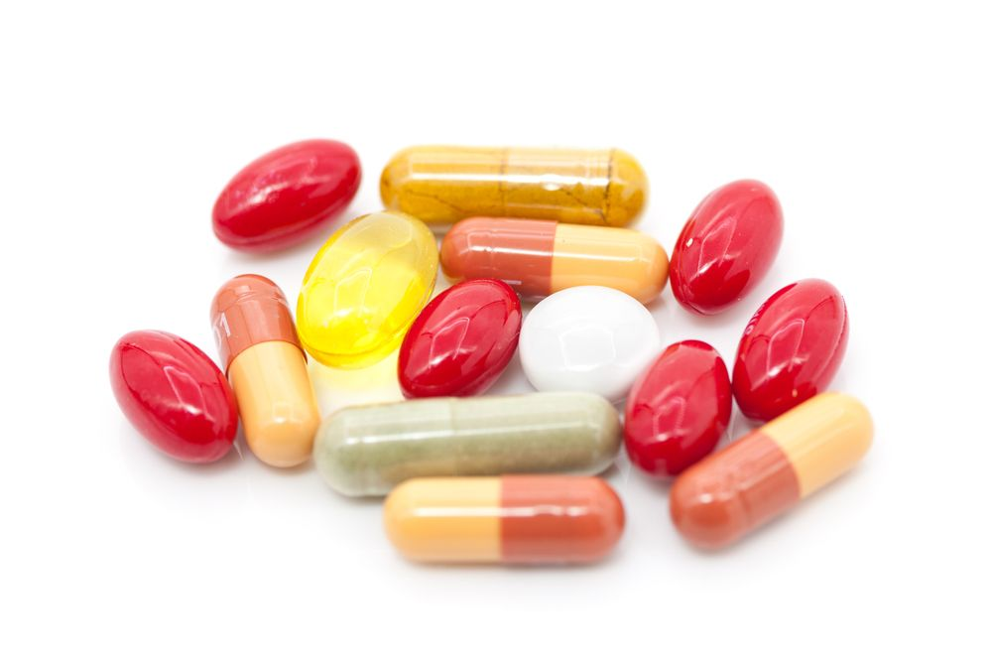
What are Barbiturates??

Slide 4
Barbiturates are central nervous depressants
They reduce the activity of nerves causing muscle relaxation
Barbiturates are one of the older classes of medications.

Slide 5
Barbiturates are medications used for treating headaches, insomnia, and seizures
Barbiturates affect gamma-aminobutyric acid (GABA), a neurotransmitter (chemical) that nerves use to communicate with one another.

Slide 6
Street Names
Downers
Blue heavens
Blue velvet
Yellow jackets
Mexican yellows
Purple hearts
Goof balls

Slide 7
https://www.youtube.com/watch?v=ht_8EXzCfWg

Slide 8
Barbiturates Available in the US
Amobarbital (Amytal)
Butabarbital (Butisol)
Pentobarbital (Nembutal)
Belladonna and phenobarbital (Donnatal)
Secobarbital (Seconal)
Butalbital/acetaminophen/caffeine (Esgic, Fioricet)
Butalbital/aspirin/caffeine (Fiorinal Ascomp, Fortabs)

Slide 9
Common Side Effects of Barbiturates
Dizziness
Lightheadedness
Sedation
Headache
Vomiting
Abdominal pain
Nausea

Slide 10
https://www.youtube.com/watch?v=MzWIJDF6-vA

Slide 11
Types of barbiturates
Amobarbital and pentobarbital are available as injections.
Butabarbital, phenobarbital, belladonna and phenobarbital, are available as tablets.
Butalbital/acetaminophen/caffeine, butalbital/aspirin/caffeine, and secobarbital are available as capsules.
Butabarbital, phenobarbital, belladonna and phenobarbital, are available as oral liquids.

Slide 12
Barbiturates During Pregnancy
Amobarbital, Phenobarbital, Pentobarbital, Secobarbital should not be used during pregnancy
FDA has listed belladonna, Butalbital/Acetaminophen/Caffeine as no evidence of safe and effective use of Barbiturates established for pregnant women
Risk to the infant cannot be ruled out. It is not known whether barbiturates enter breast milk

Slide 13
https://www.youtube.com/watch?v=kvSqNnhnKgQ

Slide 14
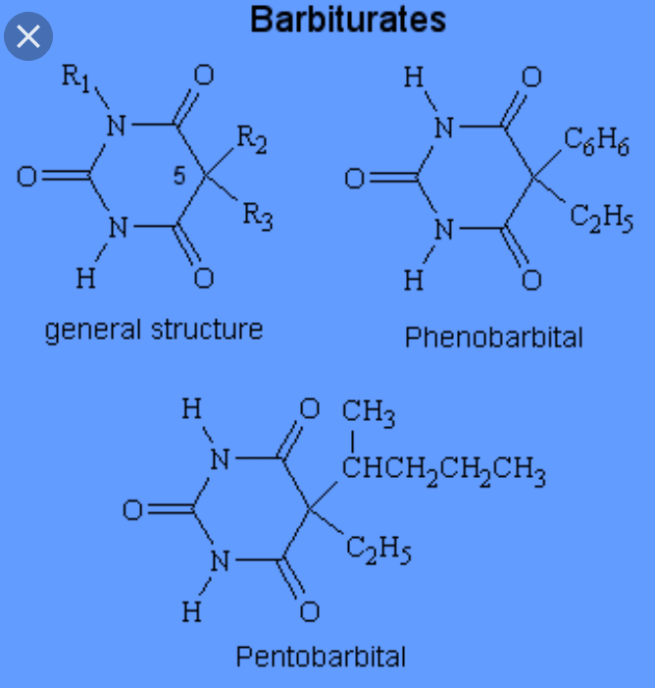
Structure Of Barbiturates

Slide 15
Diseases treated by Barbiturates
Epilepsy
Acute migraines
Anaesthesia
Cluster Headaches
It can also be used in assisted suicide by doctors or by government for capital punishment

Slide 16
Barbiturates overdose
Some of the symptoms that are witnessed immediately after overdose include lack of coordination, drowsiness, staggering, poor judgement, shallow breathing and difficulty in thinking
In severe cases of overdose, the patient might be in a coma or even die

Slide 17
TOLERANCE AND BARBITURATES
Regular use of barbiturates may cause one to develop tolerance
This occurs when people have used these drugs for a long period of time
Withdrawal can be a complicated process especially if one has used them for over 10 years
Helping patients recover from the use of barbiturates includes treatment with benzodiazepine

Slide 18
Substance Abuse and Mental Health Services Administration
SAMHSA’s National Helpline – 1-800-662-HELP (4357)
The service is confidential
Open 24/7, 365 days a year
In the first quarter of 2018, the Helpline received an average of 68,683 calls per month
Information service, in English and Spanish, for individuals and family members facing mental and/or substance use disorders.

Slide 19
References
C. (2014, May 14). National Helpline. Retrieved from https://www.samhsa.gov/ find-help/national-helpline
DEA / Drug Fact Sheets. (n.d.). Retrieved from h ttps://www.dea.gov/druginfo/factsheets.shtml
Martini, T., Coon, D. L., & Mitterer, J. O. (2019). Introduction to psychology: Gateways to mind and behavior. Australia: Cengage.
National Institute on Drug Abuse. (n.d.). Methamphetamine. Retrieved from https://www.drugabuse. gov/publications/drugfacts/methamphetamine
National Research Council (US) Committee on Substance Abuse Prevention Research. (1993, January 01). Illicit Drug Use in the United States. Retrieved from https://www.ncbi.nlm.nih.gov/books/NBK234579/
The Origins of Illegal Drugs in the United States. (2013, January 26). Retrieved from https://www.drugrehab.us/news/illegal-drugs-united- states

